Slide 1

Sales Analysis Report
By Nishtha Yadav.

Slide 2

About Dataset
It typically consists of rows and columns, where rows represent individual records and columns represent different attributes or features of the data.
They can include diverse types of data, such as numerical, categorical, text, or images.
A dataset is a structured collection of data often used for analysis, machine learning, and research.

Slide 3
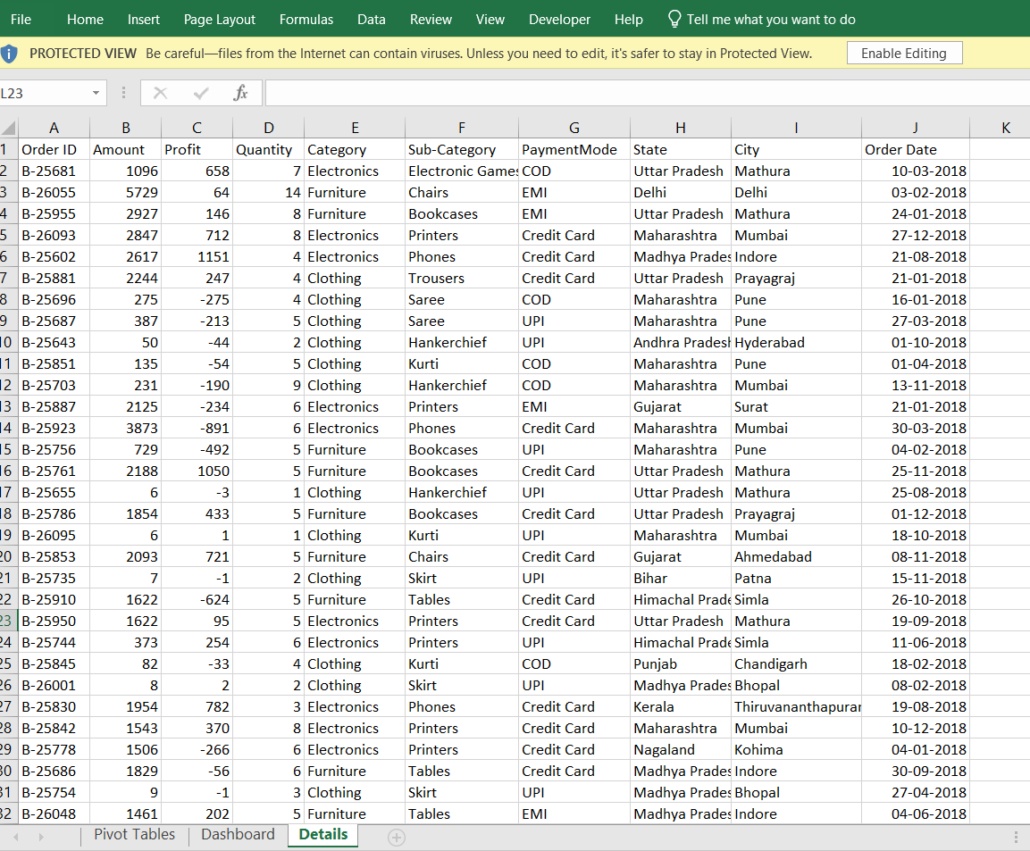
Dataset
Details of Sales with field attribute of Order ID, Amount, Quantity, Category, Sub-category, Payment mode , State, City , and Order Date

Slide 4
About Pivot Tables
It allows users to automatically organize and aggregate large datasets, enabling the exploration of data patterns and trends.
Users can drag and drop fields to dynamically rearrange and filter data for insightful reporting.
A pivot table in Excel is a powerful tool for data analysis and summarization.

Slide 5
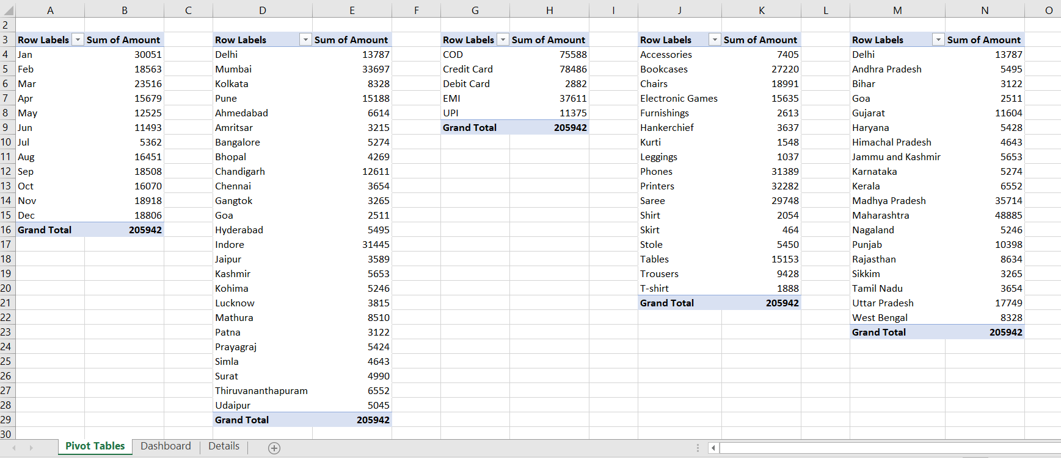
Pivot Tables
Sales Analysis:- Based on
Month
State
Mode of Payment
Products
City

Slide 6
About Dashboard
It enables quick analysis and decision-making by presenting complex data in an easily digestible format
Dashboards often update dynamically, providing real-time information and trend tracking.
An Excel dashboard is a visual interface that displays key metrics and data insights using charts, graphs, and tables

Slide 7
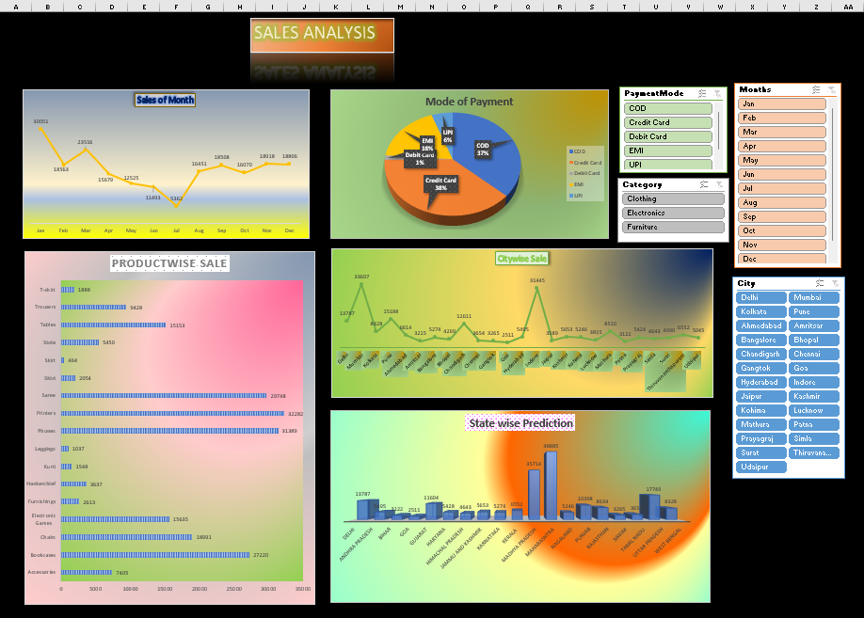
Dashboard
Report Analysis

Slide 8
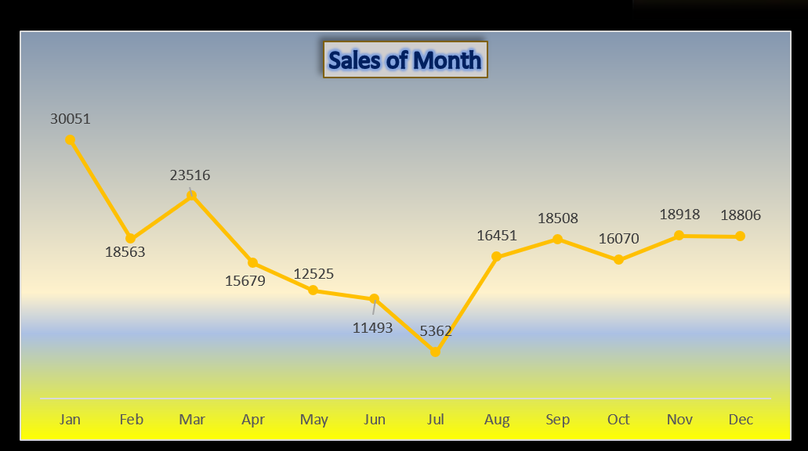
Stack Line Chart
This is a real Time Analysis where for each month.
A stacked line chart in Excel displays monthly sales,
showing cumulative data trends for multiple product categories
over time
It highlights individual contributions and overall trends,
making it easy to compare performance across multiple
products or regions over time.
We Have use this to display the sales occurred in this month Respectively.

Slide 9
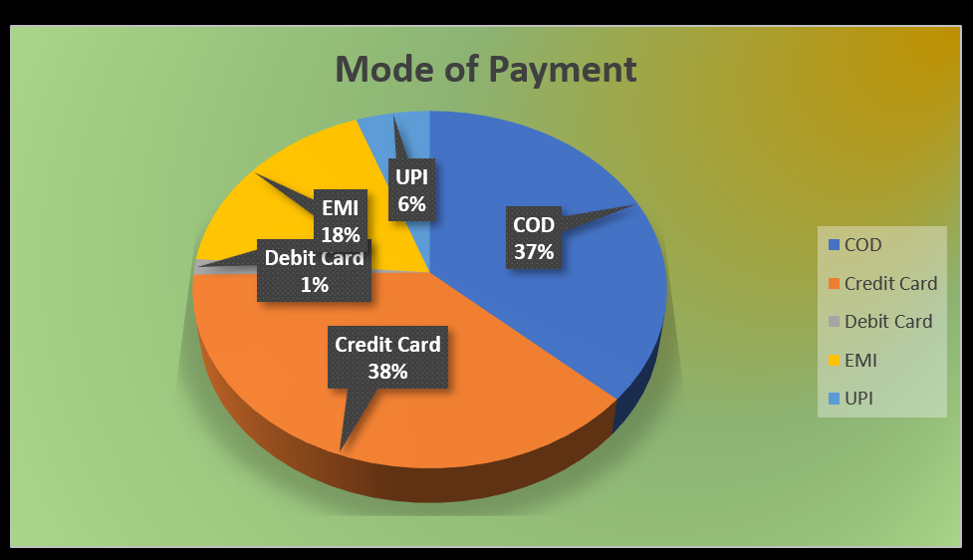
3D Pie Chart
Each slice's size corresponds to the proportion of sales made via each payment method, making it easy to compare and analyze payment preferences
A 3D pie chart here visually represents the sales distribution across different modes of payment.

Slide 10
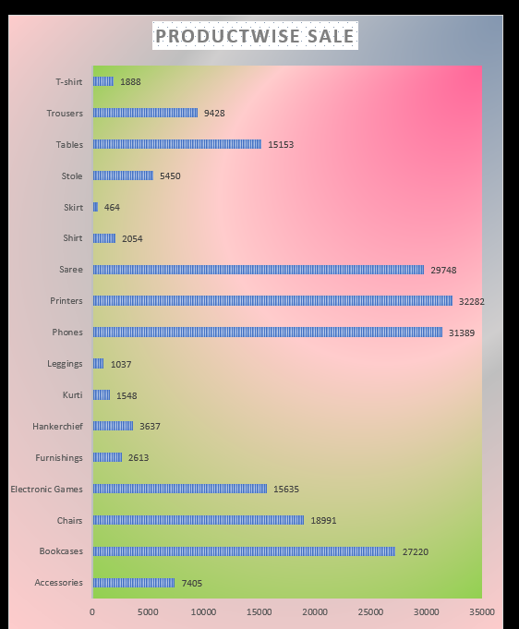
Stacked Bar
It shows the cumulative total and individual product contributions, allowing easy comparison of sales performance across multiple products in a single view.
A stacked bar chart here illustrates sales for different products by stacking bars for each category.

Slide 11
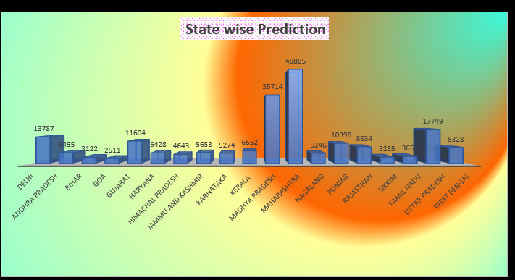
3D stacked Column
It shows the total projected sales and individual contributions from different states, making it easy to compare and analyze regional sales performance.
A 3D stacked column chart in Excel visualizes state-wise sales predictions by stacking columns for each state.

Slide 12
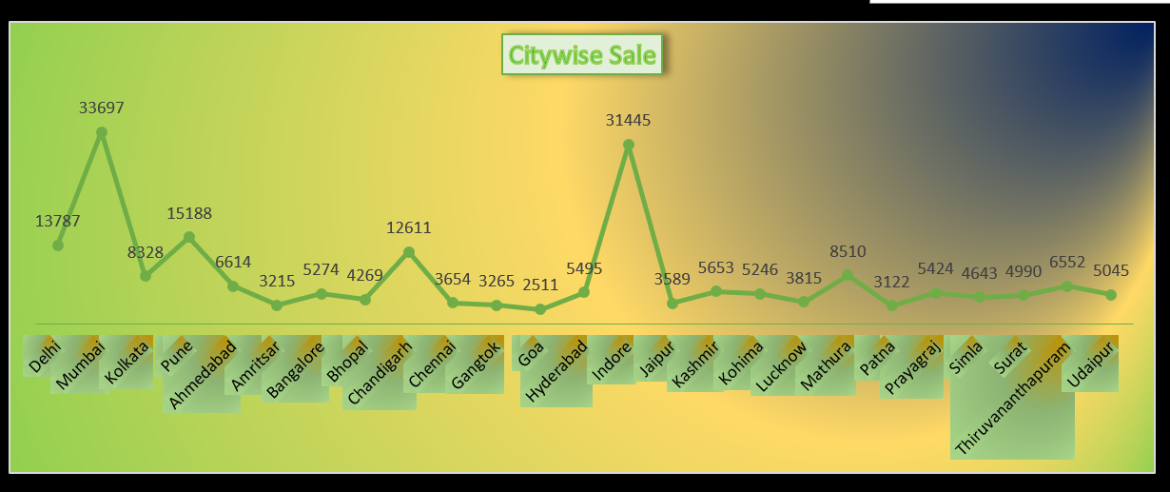
Stacked line with markers
A stacked line chart with markers here illustrates city-wise sales predictions by stacking lines with markers for each city. It highlights cumulative sales trends and individual city contributions, offering insights into sales performance across various cities over time.

Slide 13
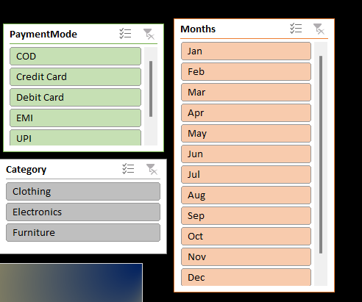
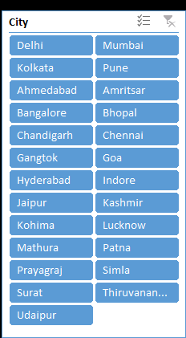
Slicers
Slicers used here to provide interactive filtering for sales data across multiple dimensions: month, city, category, and mode of payment. They allow users to easily slice and dice data, dynamically refining views to analyze sales trends by specific criteria, enhancing data exploration and decision-making capabilities.

Slide 14


Thank You
Nishtha Yadav

